Slide 1





RRMS
Restaurant Reservation
Management

Slide 2

TABLE OF CONTENTS
1
Introduction
2
RRMS
Problem and solution
Our Website
3
Limitations
4
Ending
Our website’s limitation
Tools used & Our team

Slide 3

1
Introduction
Problem and solution

Slide 4

1.1 Problem
Lack of reserving tables
through websites

Slide 5

Table reservation
Choose my appropriate start date and time
Choose my end date and time
Admin can view reservations
bon appétit
1.2 Solution

Slide 6

2
RRMS
Our website
Restaurant Reservation
Management System

Slide 7


2.1 RRMS Main core
Customer side
Admin side

Slide 8


Customer side

Slide 9
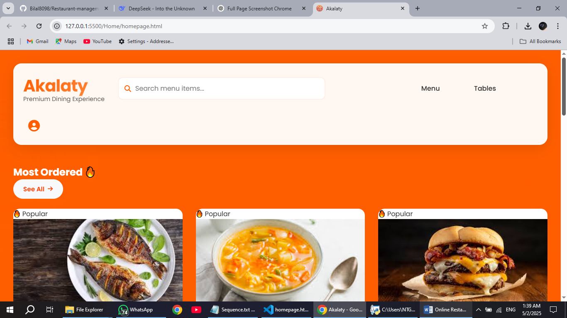
2.2.1 Main page (Homepage)

Slide 10
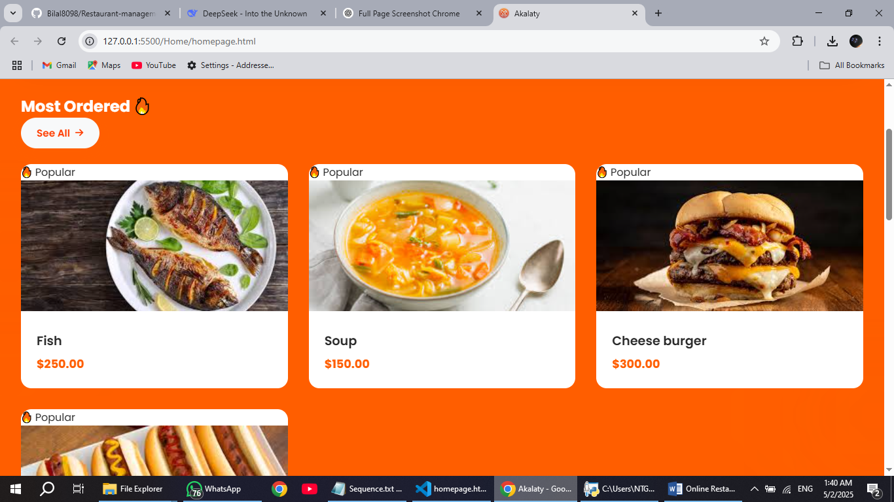
2.2.2 (Menu section)

Slide 11
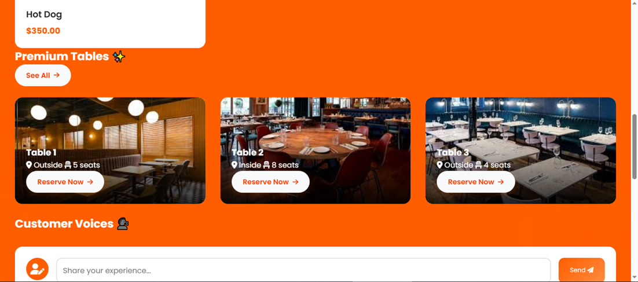
2.2.3 (Tables section)

Slide 12
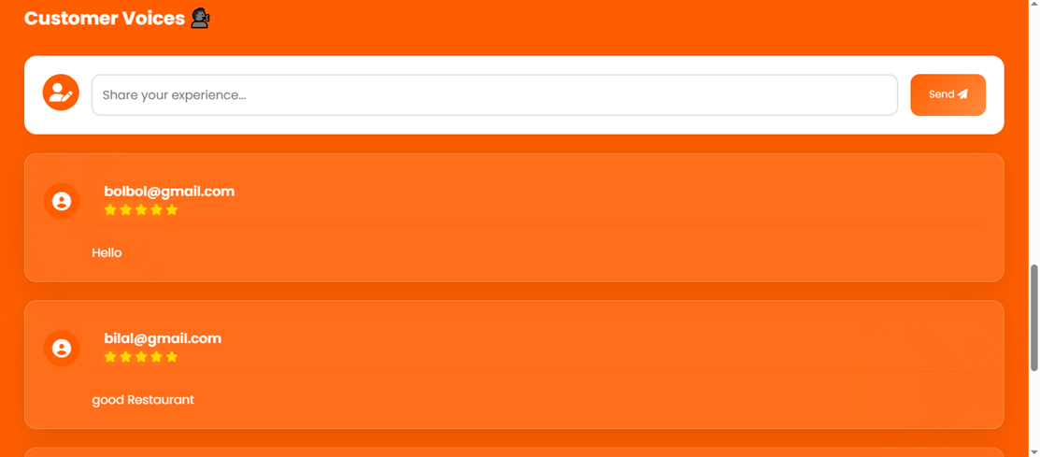
2.2.4 (Feedbacks section)

Slide 13
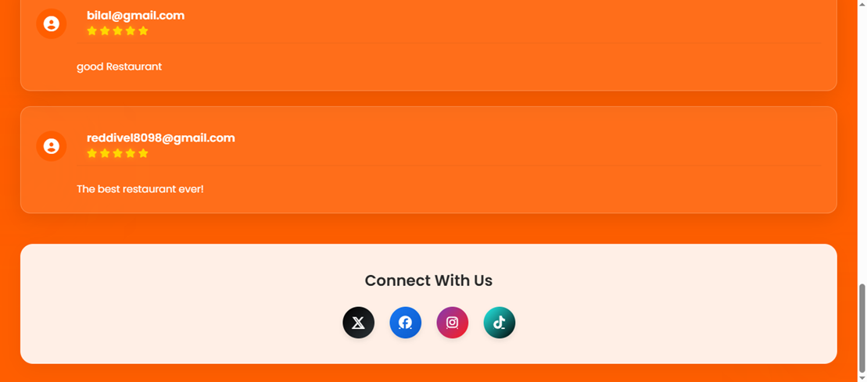
2.2.5 (Contact us section)

Slide 14
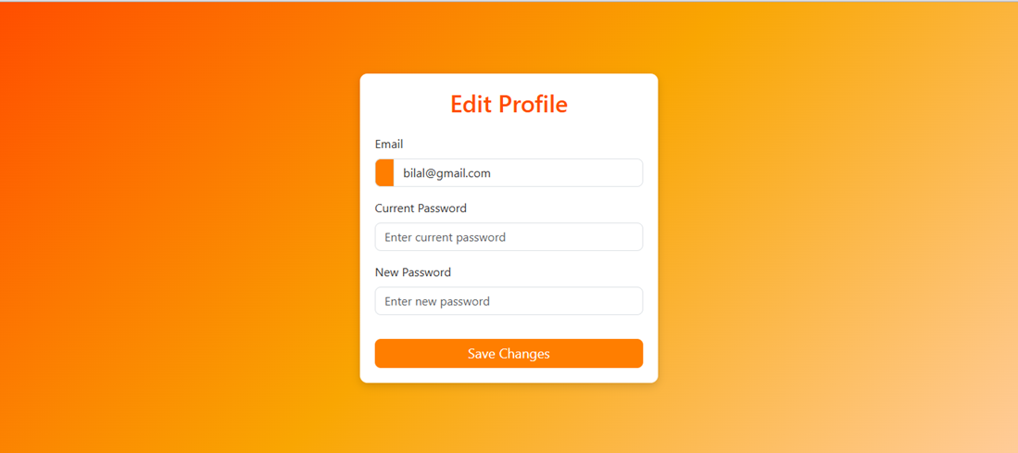
2.2.6 (My profile section)

Slide 15

2.3
Menu page

Slide 16
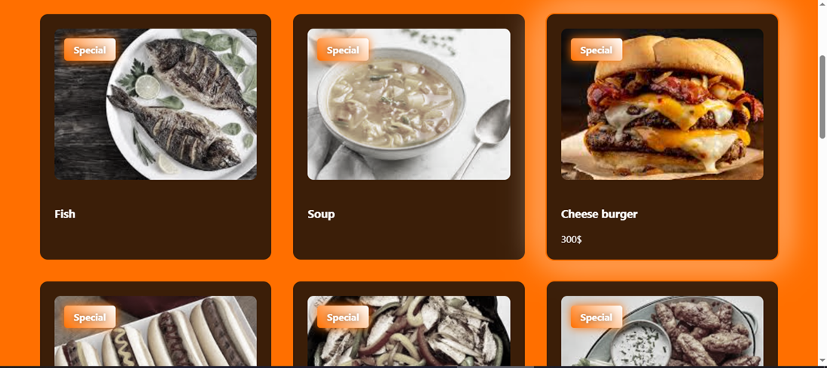
2.3 (Menu page)

Slide 17
3
Tables page

Slide 18
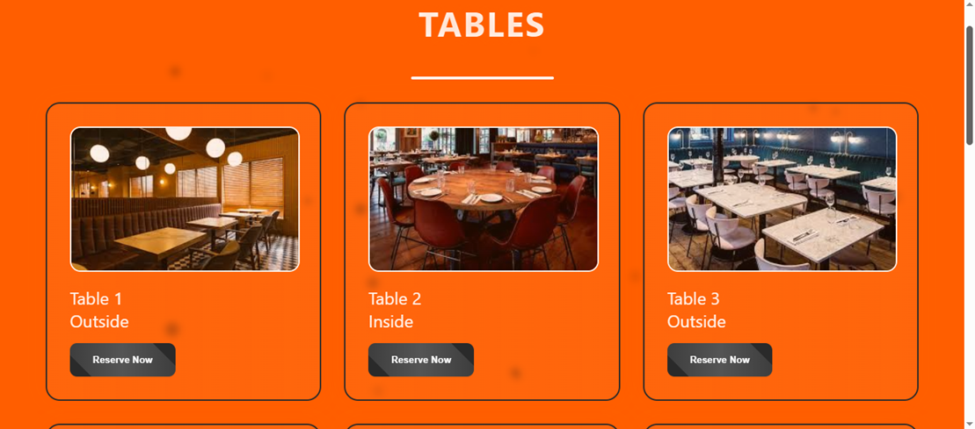
2.3.1 (Tables page)

Slide 19
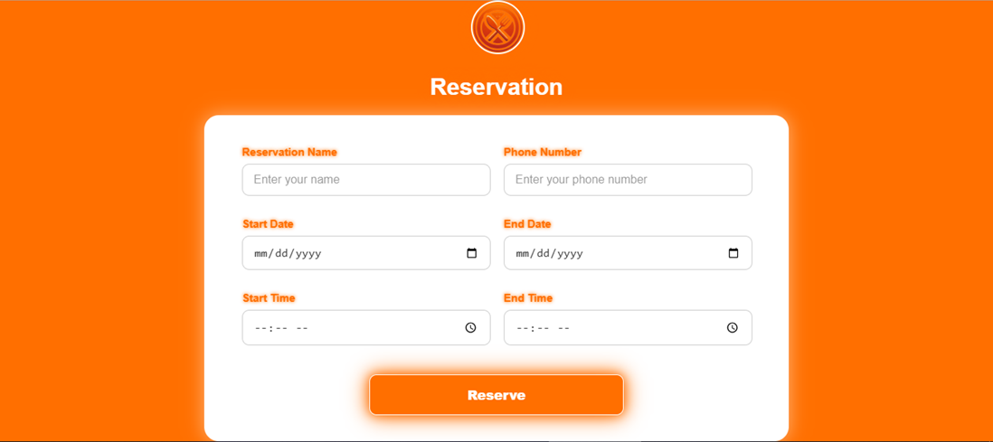
2.3.2 (Table reservation)

Slide 20

2.3.3 Let’s stop here
A minor issue will
face every reservation
system
Avoiding time conflicts
or reservation overlapping

Slide 21
Let’s stop here
Our system solves this problem!
Just by checking whether this table is reserved at this time or not?

Slide 22
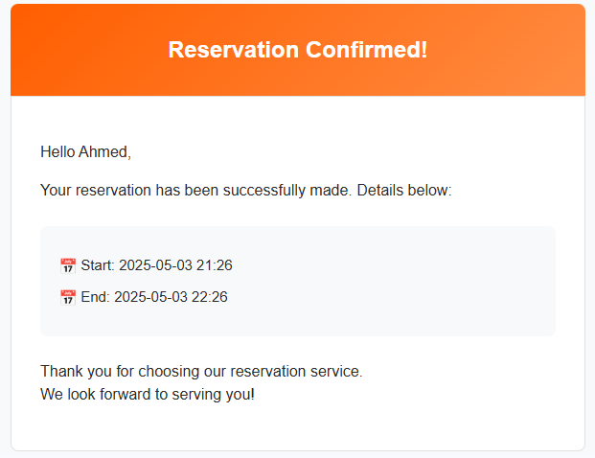
2.3.4 (Email confirmation)

Slide 23

2.4
Admin page

Slide 24
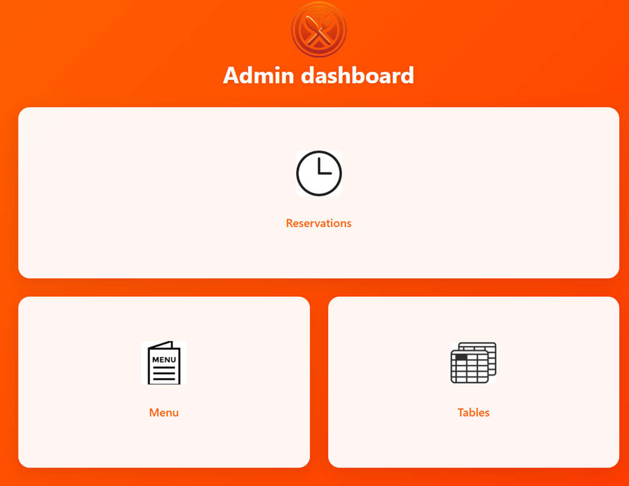
2.4.1 (Main page)

Slide 25
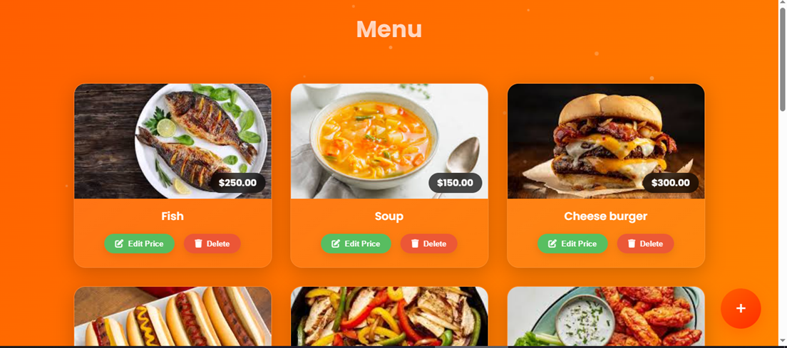
2.4.2 (Menu page)

Slide 26
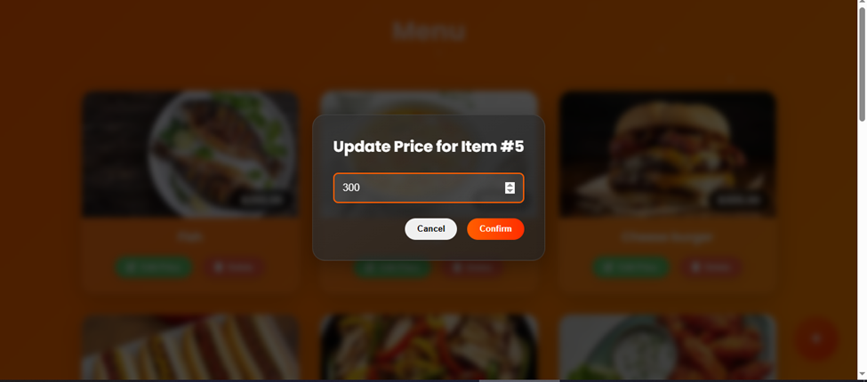
2.4.3 (Menu Edit)

Slide 27
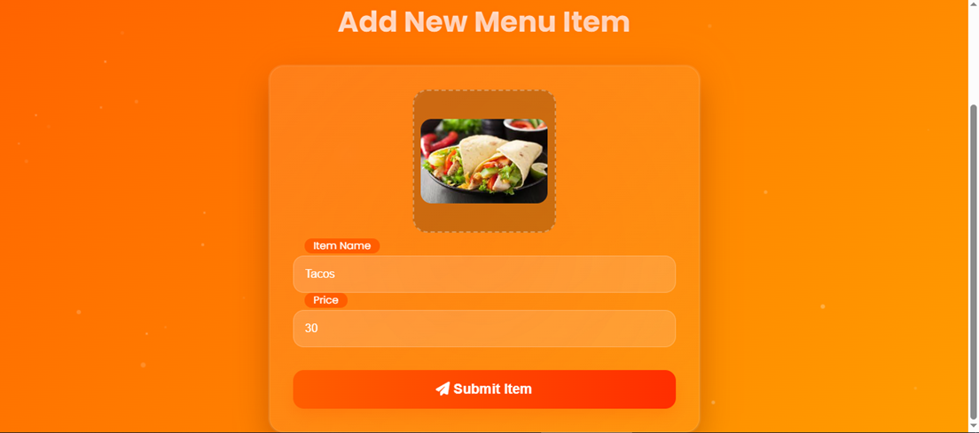
2.4.4 (Add Menu item)

Slide 28
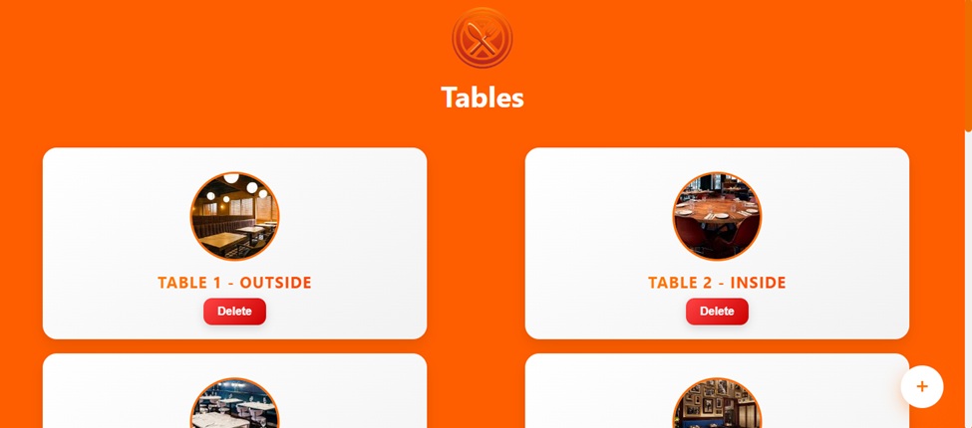
2.4.5 (Tables page)

Slide 29
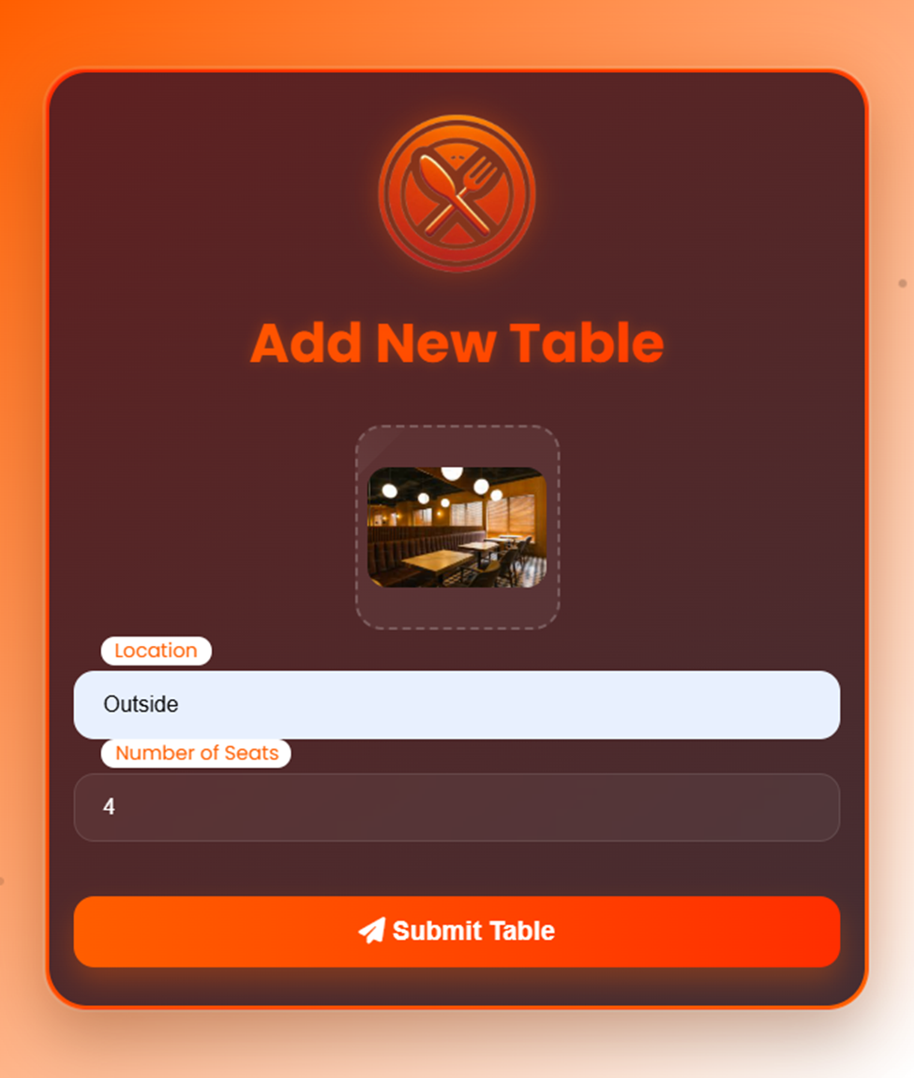
2.4.6 (Add Table)

Slide 30
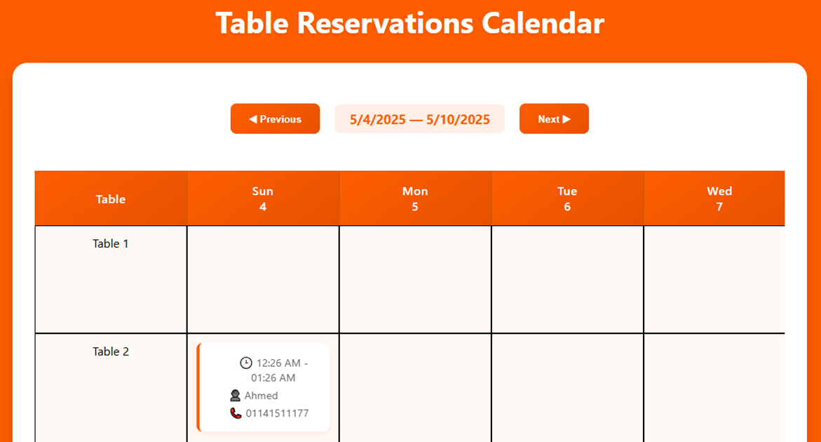
2.4.7 (Reservations view)

Slide 31
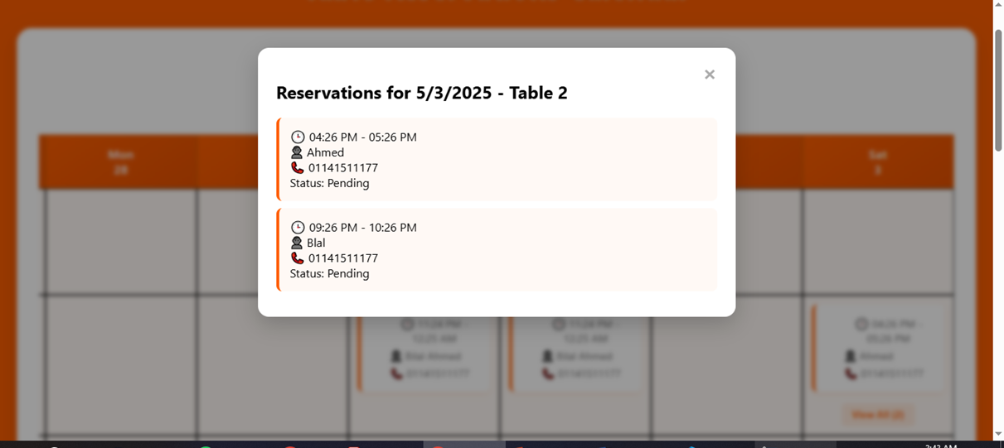
2.4.8 (View all reservations)

Slide 32

3
Limits

Slide 33


Limitations
Offers announcement 📢
Ordering
Announcing new offers on the website
Lack of setting an order

Slide 34

4
Tools
Used

Slide 35




Tools Used
HTML, CSS & JavaScript
Postgresql DBMS
Python
HTML, CSS for UI
Js for responding data
For managing database
For managing API to interact with database using Flask web framework

Slide 36
Thank you!
Leader: bilal ahmed
Members:
Mohamed emad
Haneen Ebrahim
Youssef sayed
Menna Mohamed
Mohamed khaled
bon appétit!

